Slide 1


Slide 2
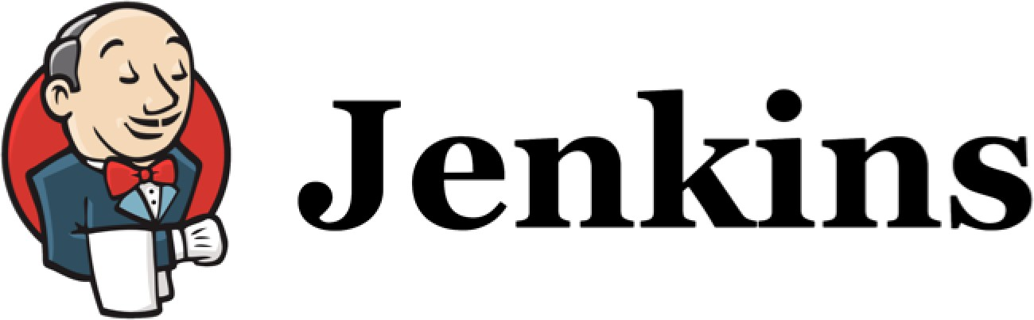
Continuous Integration

Slide 3
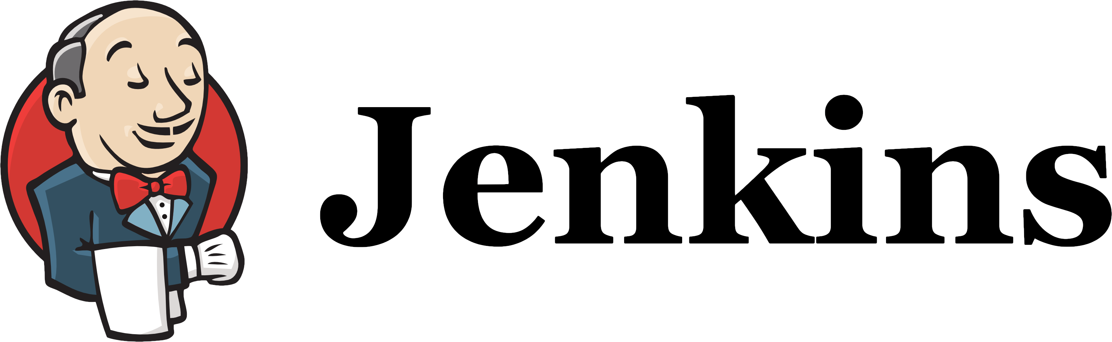
Continuous Integration
What is Continuous Integration?
Why do we need it?
Different phases of adopting Continuous Integration

Slide 4
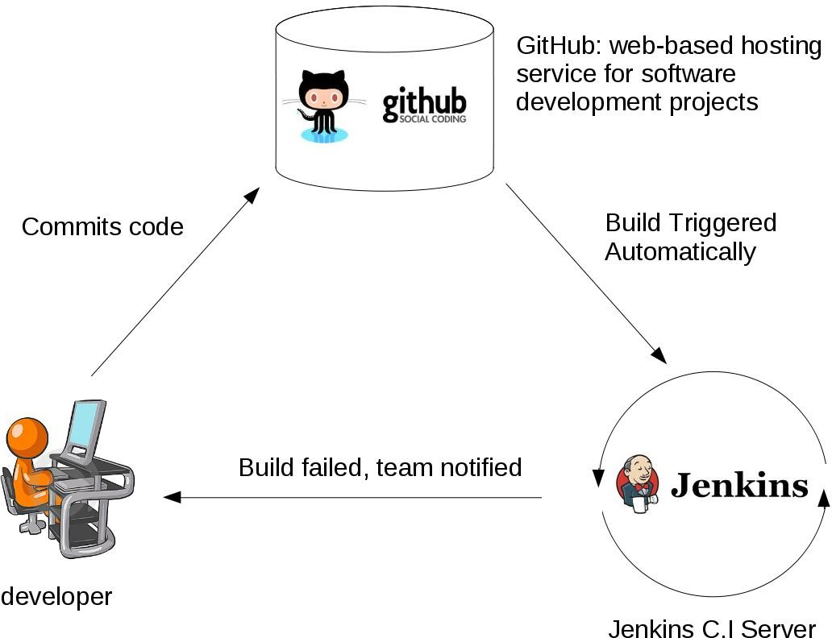
What is Continuous Integration?
Developers commit code to a shared repository on a regular basis.
Version control system is being monitored. When a commit is detected, a build will be triggered automatically.
If the build is not green, developers will be notified immediately.

Slide 5
Why do we need Continuous Integration?
Detect problems or bugs, as early as possible, in the development life cycle.
Since the entire code base is integrated, built and tested constantly , the potential bugs and errors are caught earlier in the life cycle which results in better quality software.

Slide 6
Different stages of adopting Continuous Integration

Slide 7

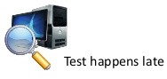


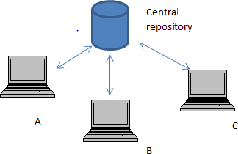
Stage 1:
No build servers.
Developers do NOT commit on a regular basis.
Changes are integrated and tested manually.
Few releases.
Few commits

Slide 8
Stage 2:
Automated builds are scheduled on a regular basis.
Build script compiles the
application and runs a set of automated tests.
Developers now commit their
changes regularly.
Build servers would alert the
team members in case of build failure.
Build nightly
Build and run tests

Slide 9
Stage 3:
Triggered atomically
A build is triggered whenever new code is committed to the central repository.
Broken builds are usually treated as a high priority issue and are fixed quickly.
Build and run tests

Slide 10
Stage 4:
Triggered atomically
Automated code quality and code coverage metrics are now run along with unit tests to continuously evaluate the code quality.
Is the code coverage increasing?
Do we have fewer and fewer build failures?
Build, run code quality and code coverage metrics along with tests

Slide 11
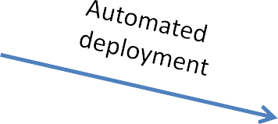

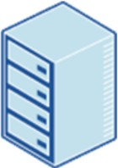
Stage 5:
Triggered atomically
Automated Deployment
Production

Slide 12
Continuous Integration Continuous Delivery Continuous Deployment

Slide 13
Continuous Integration
The practice of merging development work with the main branch constantly.
Continuous Delivery
Continual delivery of code to an environment once the code is ready to ship. This could be staging or production. The idea is the product is delivered to a user base, which can be QAs or customers for review and inspection.
Continuous Deployment
The deployment or release of code to production as soon as it is ready.

Slide 14
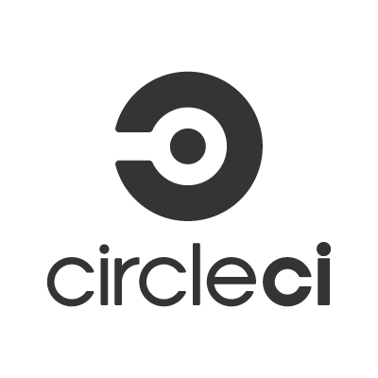

How to implement Continuous Integration?
Non-hosted solutions
Hosted solutions

Slide 15
Continuous Integration is also a mindset
Fixing broken builds should be treated as a high priority issue for all team members.
The deployment process should be automated, with no manual steps involved.
All team members should focus on contributing to high-quality tests because the confidentiality of the CI process highly depends on the quality of the tests.

Slide 16
A Brief Introduction to Jenkins and the History of Jenkins

Slide 17
What is Jenkins
Jenkins is a continuous integration and build server.
It is used to manually, periodically, or automatically build software development projects.
It is an open source Continuous Integration tool written in Java.
Jenkins is used by teams of all different sizes, for projects with various languages.

Slide 18
Why Jenkins is popular
Easy to use
Great extensibility
Support different version control systems
Code quality metrics
Build notifiers
UI customization

Slide 19
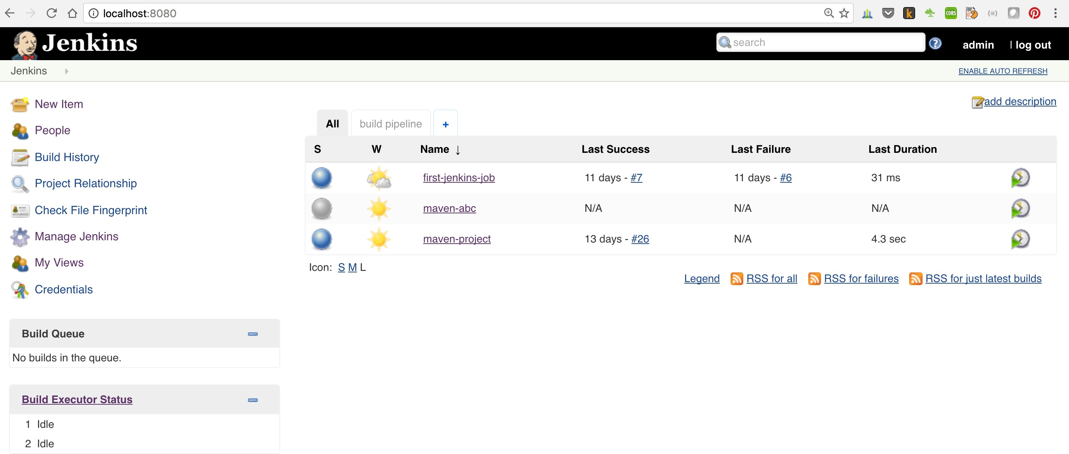

Slide 20
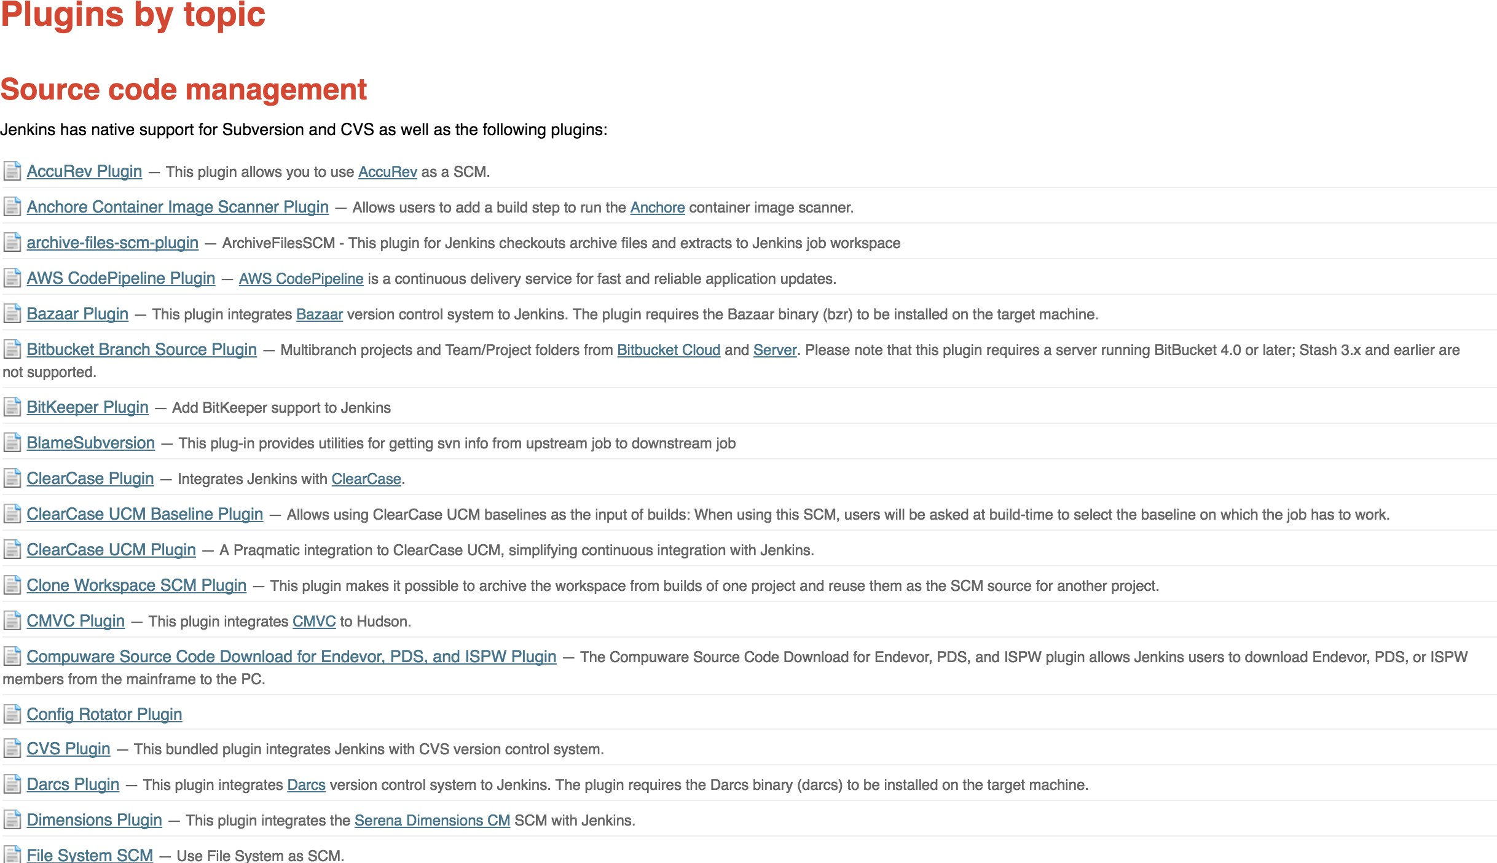

Slide 21


The History of Jenkins
Hudson was started in 2004 at Sun by Kohsuke Kawaguchi as a hobby project.
First release in 2005.
Kohsuke worked on Hudson full time in early 2008.
Became the leading Continuous Integration solution with a market share of over 70% in 2010.
Renamed to Jenkins in 2011.

Slide 22
Install Java on our local machine

Slide 23
Java Version Requirement
Jenkins requires minimum Java 7 to be installed.
It’s recommended to install Java 8.
NOTE: Currently Java 9 is NOT supported for this course due to some Jenkins plugin incapability issues.

Slide 24
JAVA_HOME environment variable
JAVA_HOME environment variable points to the installation path for the Java Development Kit.
It is required by other applications which use Java.
If you are using Mac, you can follow this lecture to configure JAVA_HOME.
If you are using Windows or Linux, you can skip this lecture and follow the guide on the next text lecture.

Slide 25
Install Jenkins on our local machine

Slide 26
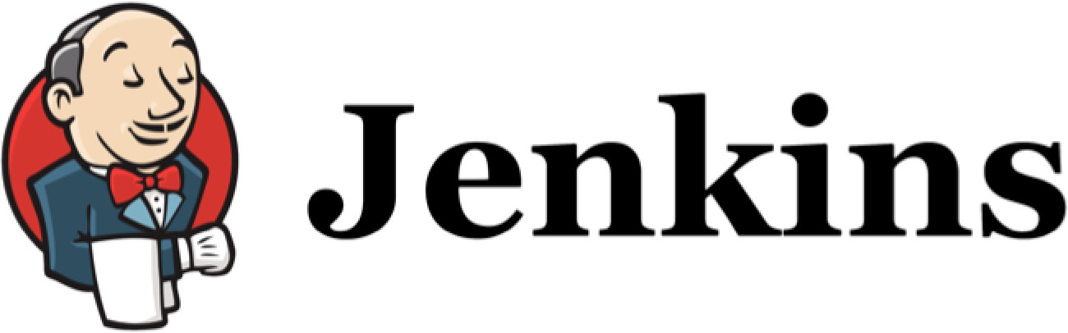
Jenkins’ Master and Slave Architecture
Some Important Jenkins’ Terminologies

Slide 27
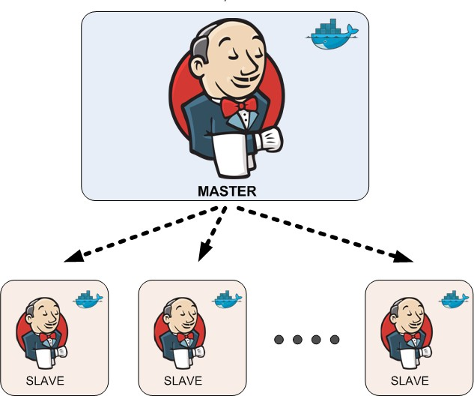
Jenkins’ Master and Slave Architecture
Master:
Schedule build jobs.
Dispatch builds to the slaves for the actual job execution.
Monitor the slaves and record the build results.
Can also execute build jobs directly.
Slave:
Execute build jobs dispatched by the master.

Slide 28
Job / Project
Those two terms are used interchangeably. They all refer to runnable tasks that are controlled / monitored by Jenkins.

Slide 29
Slave / Node
Slaves are computers that are set up to build projects for a master.
Jenkins runs a separate program called "slave agent" on slaves.
When slaves are registered to a master, a master starts distributing loads to slaves.
Node is used to refer to all machines that are part of Jenkins grid, slaves and master.

Slide 30
Executor
Executor is a separate stream of builds to be run on a node in parallel.
A Node can have one or more executors.

Slide 31
Build
A build is a result of one of the projects.

Slide 32
Plugin
A Plugin, like plugins on any other system, is a piece of software that extends the core functionality of the core Jenkins server.

Slide 33
Jenkins UI Overview

Slide 34
Create our first Jenkins Job

Slide 35
Run our first Jenkins job

Slide 36
Install GIT and GitHub plugin

Slide 37
Install and Configure Maven

Slide 38
What does Maven do?
Maven describes how the software is built.
Maven describes the project’s dependencies.

Slide 39



Java Build Tools

Slide 40
Add the bin directory of this new folder to the Path environment variable so that our operating system knows where to find our maven executable.

Slide 41
Configure Jenkins for our Maven-based project

Slide 42
Create our first Maven-based Jenkins project

Slide 43
Run our first Maven-based Jenkins project

Slide 44
Maven pom.xml file
Describe the software project being built, including
The dependencies on other external modules.
The directory structures.
The required plugins.
The predefined targets for performing certain tasks such as compilation and packaging.

Slide 45
Different Phases in Maven Build Lifecycle
validate Validate the project is correct and all necessary information is available.
Run any checks on results of integration tests to ensure quality criteria are met. Install the package into the local repository, for use as a dependency in other projects locally.
Copy the final package to the remote repository for sharing with other developers and projects.
compile test
Compile the source code of the project.
Test the compiled source code using a suitable unit testing framework.
package Take the compiled code and package it in its distributable format.
verify install
deploy

Slide 46
Maven Build Phases
These lifecycle phases are executed sequentially to complete the default lifecycle.
We want to specify the maven package command, this command would execute each default life cycle phase in order including validate, compile, test before executing package.
We only need to call the last build phase to be executed.

Slide 47
Configure Jenkins to poll source code changes periodically

Slide 48
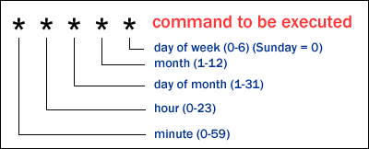
Cron Syntax
In Cron, each line consists of 5 fields separated by TAB or whitespace.

Slide 49
Cron Syntax
To specify multiple values for one field:
*
M-N A,B,Z
all valid values
a range of values enumerates multiple values

Slide 50
Cron Syntax
Examples:
0 0 * * *
every day at midnight
0 2-4 * * *
2 am, 3 am and 4 am every day

Slide 51
Other Build Triggers of Jenkins

Slide 52
When to use scheduled build(build periodically option)?
Very long running build jobs, where quick feedback is less critical.
Some intensive load and performance tests which may take several hours to run.

Slide 53
Jenkins code quality metrics report

Slide 54
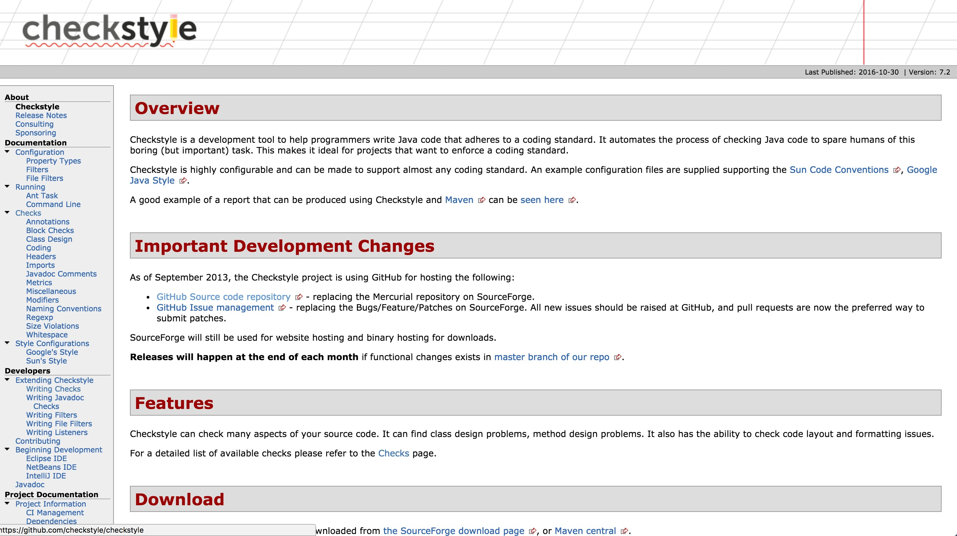
Checkstyle is a code static analysis tool to help programmers to write Java code that adheres to a coding standard such as
Avoiding multiple blank lines;
Removing unused variables;
Enforcing correct indentations;
…

Slide 55
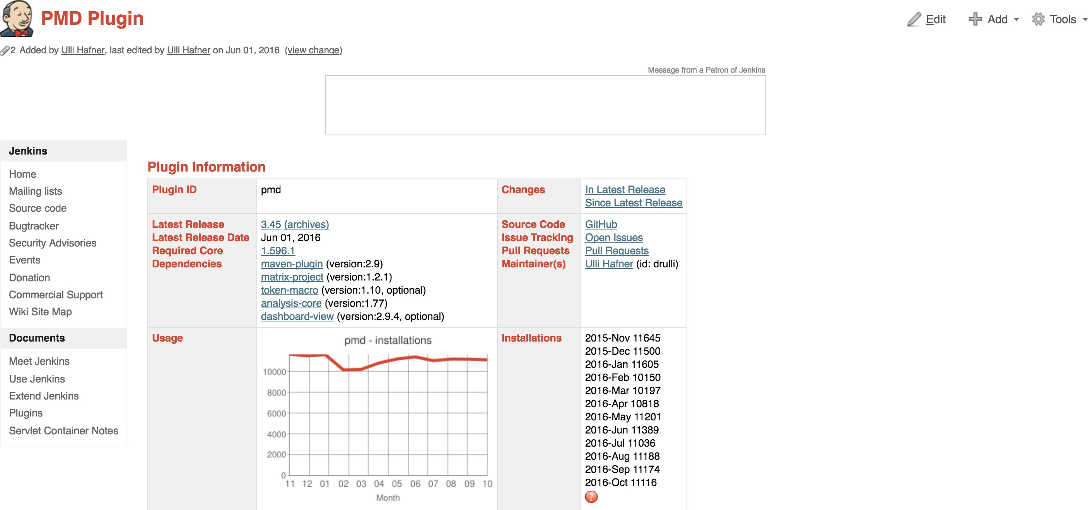
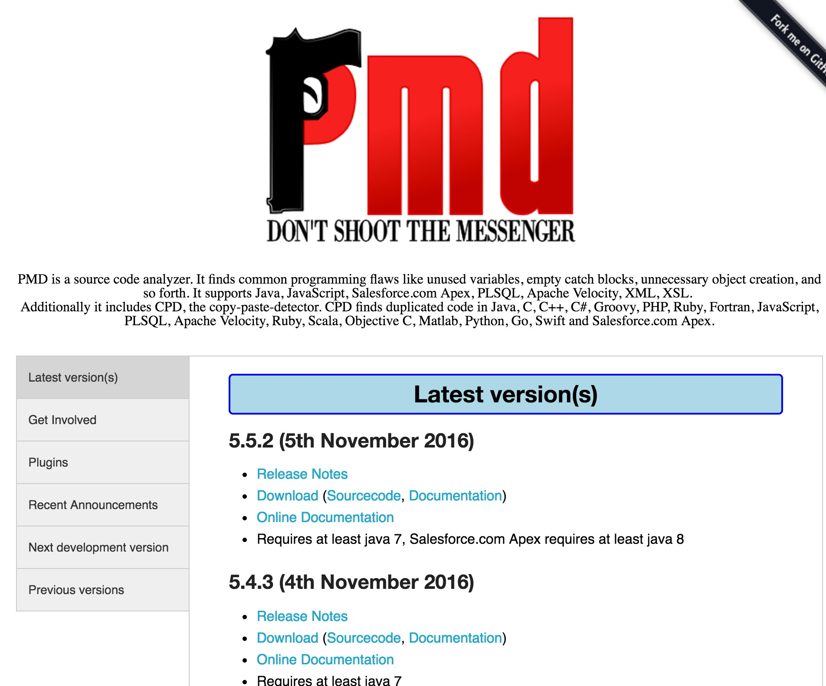

Slide 56
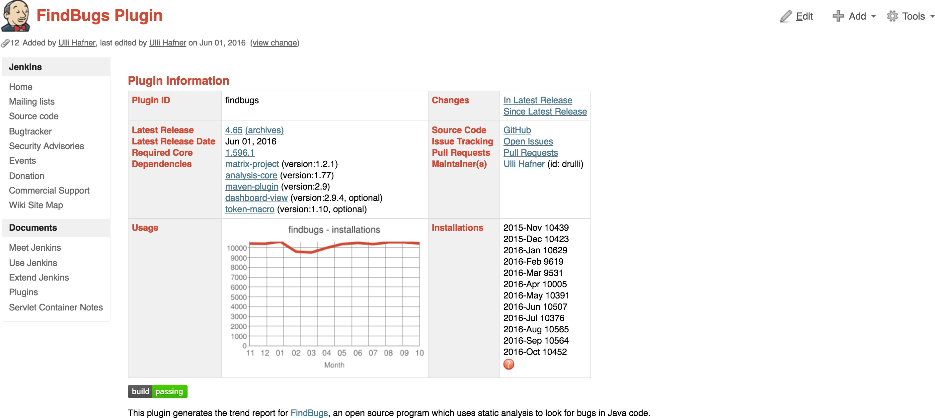
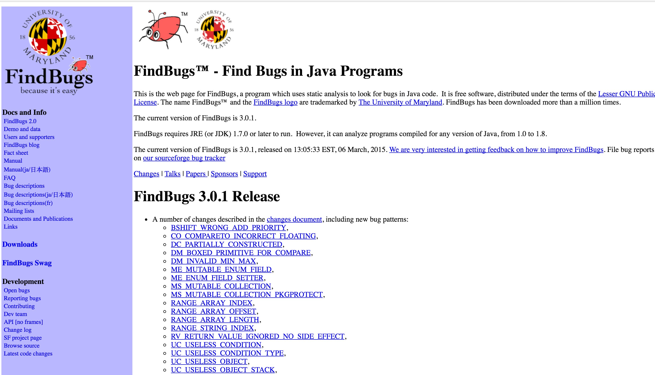

Slide 57
Jenkins’ support for other build systems (Ant, Gradle and shell scripts)

Slide 58

Apache Ant
Widely-used and very well-known build scripting language for Java.
Flexible, extensible, relatively low-level scripting language.
An Ant build script is made up of a number of targets, each target performs a particular job in the build process.

Slide 59
Gradle
Gradle is a relatively new open source build tool for the Java Virtual Machine.
Build scripts for Gradle are written in a Domain Specific Language based on Groovy.
The concise nature of Groovy scripting lets you write very expressive build scripts with very little code.

Slide 60
Archive generated artifacts

Slide 61












Continuous Integration Workflow
Compile Test Package
Staging for QE testing
Generate and archive
deploy
Artifact

Slide 62
Install and configure Tomcat as a staging environment

Slide 63

Tomcat
Tomcat is an open-source web server and provides a "pure Java” HTTP web server environment in which Java code can run.

Slide 64
Change Tomcat Server Port
Jenkins runs on port 8080.
The default port of Tomcat is also 8080.

Slide 65
Install copy artifact and deploy to container plugins
Deploy our application to staging environment

Slide 66
Jenkins Build Pipeline

Slide 67






Our Current Build Pipeline
Compile Test Package
Staging for QE testing
Upstream job
Downstream job

Slide 68
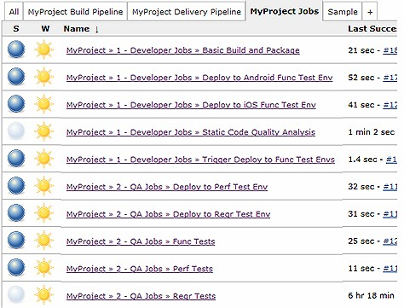
When the number of build jobs grows…

Slide 69
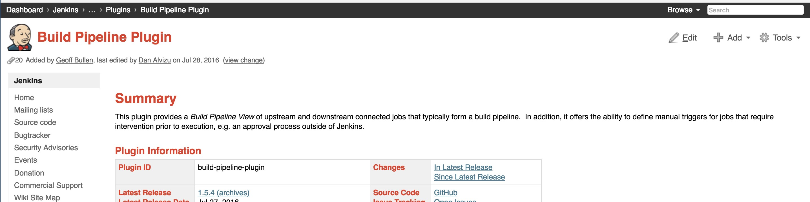
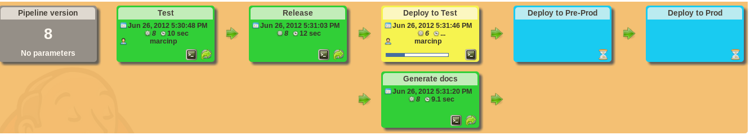
Build Pipeline Plugin

Slide 70
Parallel Jenkins Build

Slide 71

Linear Pipeline
Compile Test Package Checkstyle
Staging for QE testing

Slide 72










Parallel Pipeline
Staging for QE testing
Compile Test Package
Checkstyle

Slide 73
Continuous Delivery
Deploy our app to production

Slide 74















Full Continuous Delivery Pipeline
Compile Test Package
Staging for QE testing
Deploy to production
Manually triggered by a QE manger or release manager
Port 8090
Port 9090
Chekstyle

Slide 75


Pipeline as code
Carlos Rivas
Certified Cloud Architect| Linkedin.com/in/cjrivas

Slide 76
Benefits of a code-based pipeline
Version control
Best Practices
Less error-prone execution of jobs
Logic-based execution of steps

Slide 77
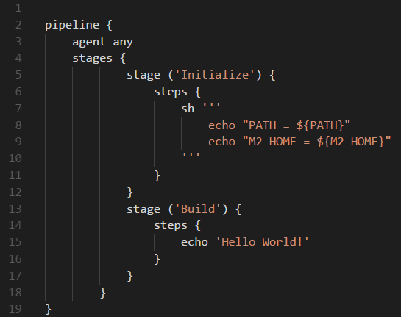
Sample Jenkinsfile

Slide 78
Pipeline as code
Automate our existing Jenkins pipeline

Slide 79
Pipeline as code
Taking our automation even further

Slide 80
Additional automation
Setup Git repository polling
Deployment to our tomcat servers
We will setup a couple of tasks to run in parallel
And we will briefly explain how to setup tomcat on EC2 in Amazon Web Services

Slide 81
Steps
Step 1: Configure AWS security groups for Tomcat servers and create key pairs.
Step 2: Provision EC2 instances on AWS to simulate staging and production environments.
Step 3: Install and run Tomcat on created AWS instances.
Step 4: Fully automate our existing Jenkins pipeline.

Slide 82
Steps
Step 1: Configure AWS security groups for Tomcat servers and create key pairs.
Step 2: Provision EC2 instances on AWS to simulate staging and production environments.
Step 3: Install and run Tomcat on created AWS instances.
Step 4: Fully automate our existing Jenkins pipeline.

Slide 83
Steps
Step 1: Configure AWS security groups for Tomcat servers and create key pairs.
Step 2: Provision EC2 instances on AWS to simulate staging and production environments.
Step 3: Install and run Tomcat on created AWS instances.
Step 4: Fully automate our existing Jenkins pipeline.

Slide 84
Steps
Step 1: Configure AWS security groups for Tomcat servers and create key pairs.
Step 2: Provision EC2 instances on AWS to simulate staging and production environments.
Step 3: Install and run Tomcat on created AWS instances.
Step 4: Fully automate our existing Jenkins pipeline.

Slide 85
Actions
Next you will need to install two instances on AWS, one for staging and one for production environment. And install tomcats on them.
Those two tomcats can use the same 8080 port as they are running on different hosts.
There is NO need to configure the tomcat users and roles, as we won’t use the deploy to container plugin anymore.

Slide 86
Local and Remote Servers
scp to remote tomcat
cp to local tomcat
instead of remote ip address, use localhost

Slide 87
Introduction to Distributed Jenkins Builds

Slide 88

Digital Ocean is a cloud computing platform and virtual machine provider which is widely used in the industry.
It is similar to AWS EC2 and Microsoft Azure, but much easier to get started with.

Slide 89
Install Jenkins Master in the Cloud

Slide 90
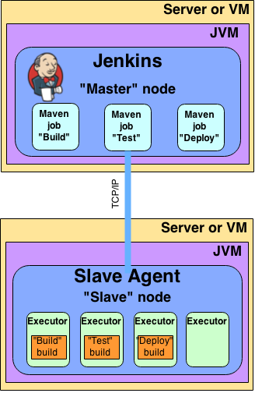
Jenkins Slave Agent

Slide 91
Different ways to start slave agent
The master can start the slave agents via SSH.
Start the slave agent manually using Java Web Start.
Install the slave agent as a Window service.
Start the slave agent directly from the command line on the slave machine.

Slide 92
Install Jenkins slaves in the cloud and form a Jenkins cluster

Slide 93
Start the slave agent
Master node will start the slave agent on the slave machine via SSH .
Automatic SSH login without password from master node to the slave node is needed.
Master node will be running as a specific user called Jenkins to start the slave agent.

Slide 94
Executor
A Jenkins executor is one of the basic building blocks which allow a build to run on a node.
Think of an executor as a single “process ID”, or as the basic unit of resource that Jenkins executes on your machine to run a build.
This number executors basically specifies the maximum number of concurrent builds that Jenkins may perform on this agent.
A good value for the number of executors to start with would be the number of CPU cores on the machine.
Setting a higher value would cause each build to take longer, but could increase the overall throughput.
For example, one build might be CPU-bound, while a second build running at the same time might be I/O-bound — so the second build could take advantage of the spare I/O capacity at that moment.

Slide 95
Concurrent Builds on Jenkins Cluster Label Jenkins Nodes

Slide 96
Label Nodes
In real life scenarios, we might want a node to be reserved for certain kinds of jobs.
For example, if you have jobs that run performance tests, you may want them to only run on a specially configured machine, while preventing all other jobs from using that machine.
To do so, you would restrict where the test jobs may run by giving them a label expression matching that machine.

